Slide 1
Progress Report
Quantum Portfolio Optimization

Slide 2
Tested 2 baselines
Random
EPS*Dividend best mix
Yfinance data into a MIP optimizer backtested per day-ticker

Slide 3
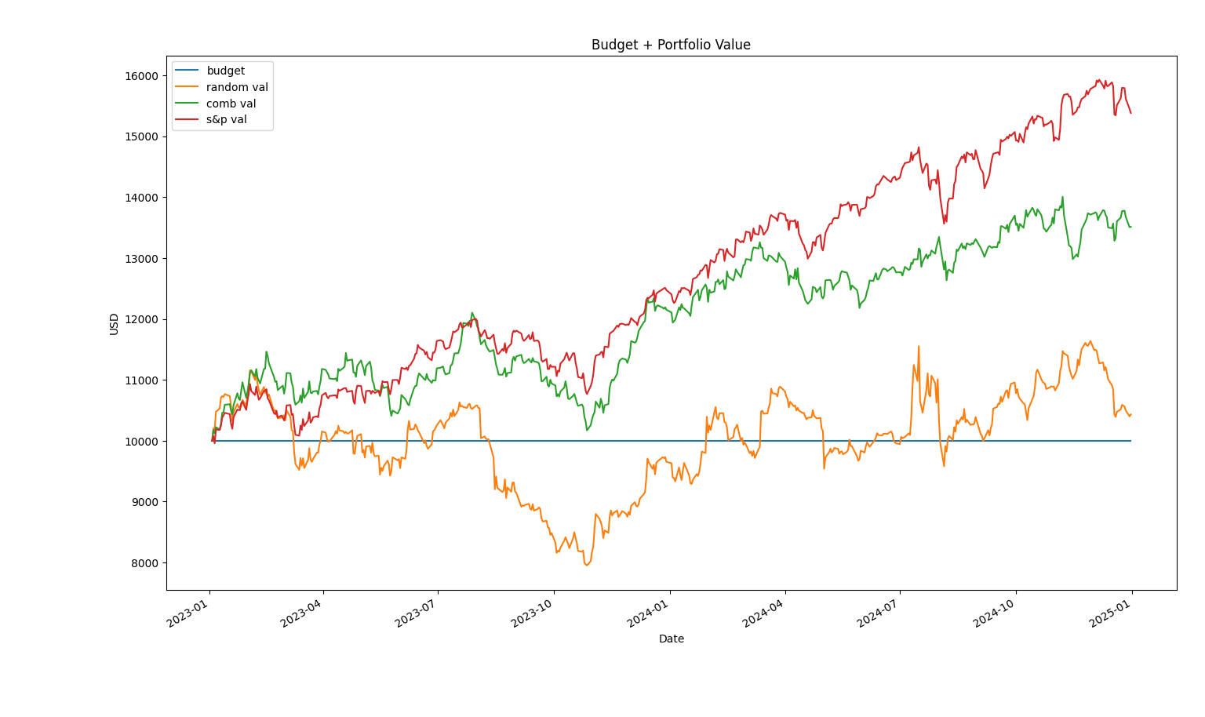
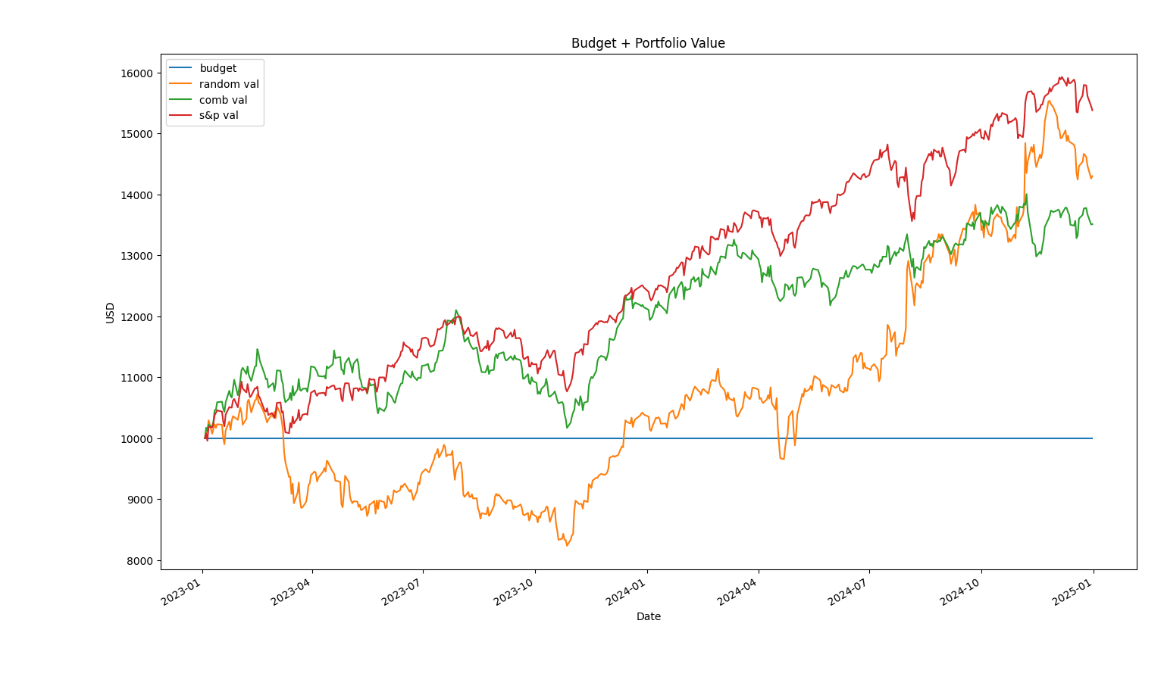
Plots
Limitations 1. MIP should allow for fractional values
2. Filtered score for stocks is very rudimentary (ML potential)
3. Random has very high variance
4. Use Gurobi or SCIP as the optimizer for MIP, official BackTrader/VectorBT for backtesting

Slide 4
Quantum Ideas
First we saw that the number of stocks can definitely be improved in terms of how many are chosen. There is no closure to this system as the alpha of the system can only be estimated.
Pipeline
Brute force selector optimization
Order blocking optimization
Quantum portfolio composition optimization
Number of stocks
Binary form
Superposition search
Quantum Annealing allows for large-scale searches without bottlenecks
Beats traditional selectors
Represents every stock value as a binary sum
Allows for fast transpose into VectorBT and lends itself to our QAOA
Looks at every combination (still brute force) in superposition
Saves time and ideal for a continuous algorithm

Slide 5
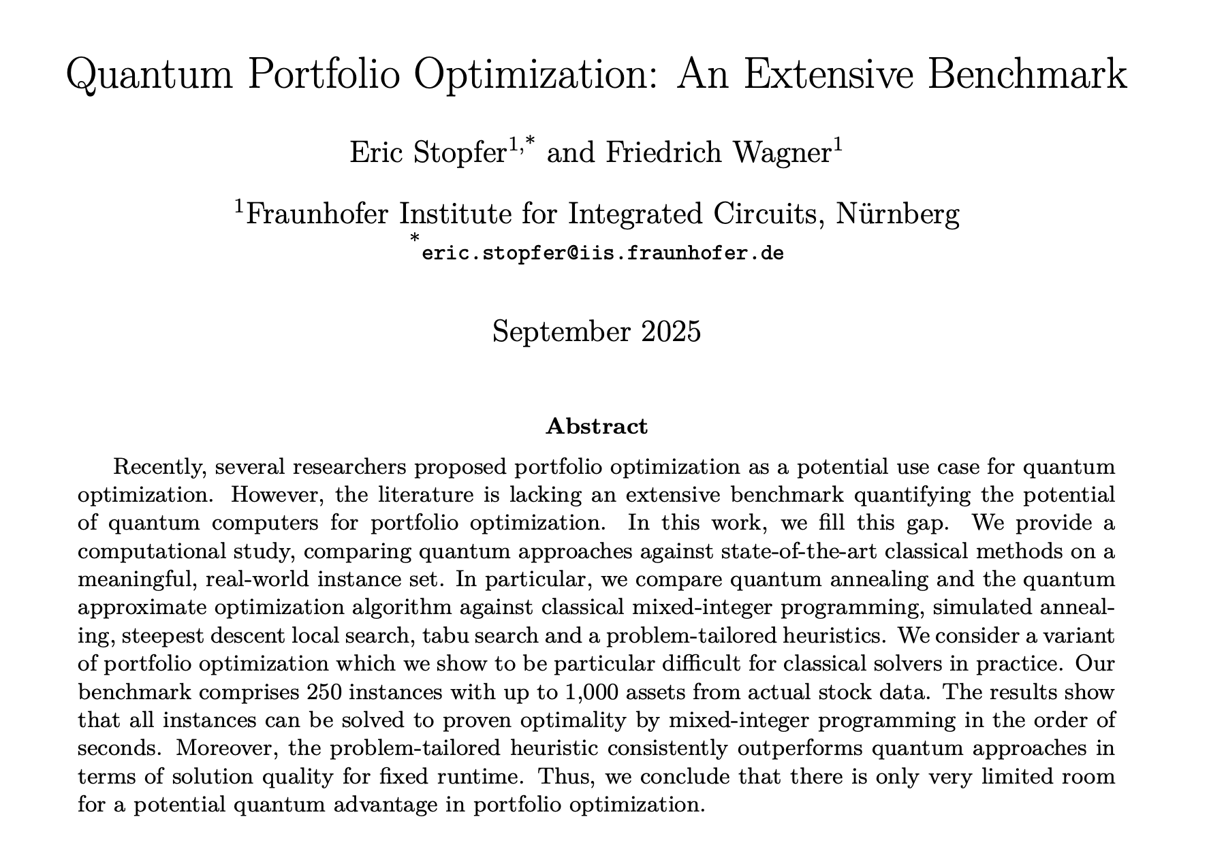
Paper Summary
From this paper, quantum methods are currently not outperforming classical methods. All instances can be solved to proven optimally by mixed integer programming. The heuristics used consistently outperform the quantum ones.
“Our main conclusion is that classical heuristics like simulated annealing, steepest descent, tabu search and a problem-specific heuristic clearly outperform QAOA and quantum annealing regarding solution feasibility and quality.”
Gurobi is 1000x faster than SCIP for problems with around 1000 assets
MinVola is the most promising variant for a potential quantum speedup.
Quantum annealing very slightly outperformed QAOA, but the results are very nuanced
Access at: https://arxiv.org/pdf/2509.17876

